Slide 1

Incidence, Microbial Patterns, and Outcomes of External Ventricular Drain Infections: A Three-Year Review at a Kenyan Tertiary Hospital
Clara Kesis: Nursing practice instructor: AKUHN
David Odada: IPC manager: AKUHN

Slide 2
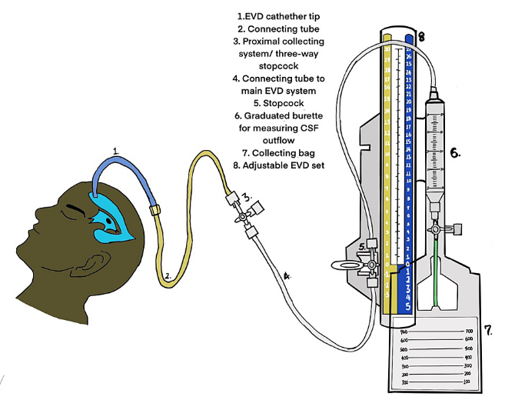
Introduction
EVD: temporary system for CSF diversion & ICP monitoring
Provides direct access to CSF which is a risk of infection
ERI (ventriculitis) has high morbidity & mortality
Global incidence: 11 infections/1,000 catheter-days; 9–20% of patients
In LMICs rates are high, (up to 24% with improvised systems)
Common organisms are CONS, S. aureus, E. coli, Acinetobacter, Klebsiella
Treatment is complicated by Biofilm formation

Slide 3
Literature Review
Prevention bundles: pre-op antibiotics, antimicrobial catheters, aseptic technique
Restricted CSF sampling reduces infection rates
Risk factors: prolonged catheter use, frequent manipulations, Intraventricular hemorrhage , CSF leak, non-tunnelled catheters
HIC studies: bundled approaches + staff education → lower ERI incidence
LMIC challenges: limited surveillance, training gaps, lack or unclear guidelines, resource constraints
African data: microbial patterns differ from Western trends
Kenya: limited facility-level data (e.g., VP shunt infections)

Slide 4
Literature review
Rojas-Lora et al(2023)study on EVD-associated infection reduction & microbiology reports that although gram-positive organisms are often implicated in the west, their center observed gram-negative microorganisms as the most frequent EVDRI pathogens; highlights local susceptibility profiles and the impact of care bundles on reducing infections
Kelemen et al., 2024 (review / antimicrobial stewardship focus)Reviews risk assessment and recommended infection-control + antibiotic-stewardship approaches for EVD infections; emphasizes tailoring empirical therapy to local antibiograms because pathogen distribution and resistance patterns vary by unit/region.

Slide 5
Justification
EVD-related infections cause significant morbidity, mortality, and prolonged hospital stay
Kenya lacks structured surveillance or national registries; microbial patterns may differ from Western settings
At AKUHN, EVD infections are not a major focus of HAI surveillance
Local evidence is needed to quantify burden, inform empiric therapy, and guide prevention strategies

Slide 6
Study Aims
Determine the incidence of EVD-related infections (ERI) among neurological patients at AKUHN
Describe microbial patterns, resistance profiles, associated with ERI

Slide 7
Methodology
Design: Single-center retrospective cohort (Aug 2022 – Aug 2025)
Location, AKUHN (300-bed tertiary hospital, strong microbiology service)
Population, Neurological patients with EVDs
Eligibility: ERI defined by CDC/NHSN criteria (positive CSF culture/Gram stain ≥24h post-EVD)
Exclusions, active CSF infection at placement, EVD dwell time <24h
Ethical approval, from AKUHN Research committee and license by NACOSTI

Slide 8
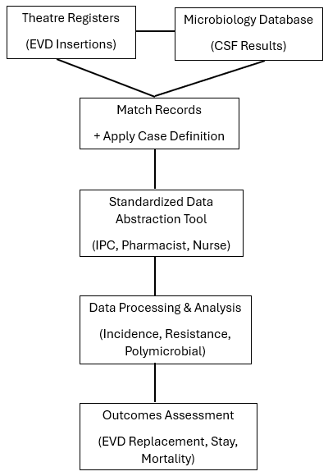
Methodology
Data management process

Slide 9
Results

Slide 10
Results

Slide 11
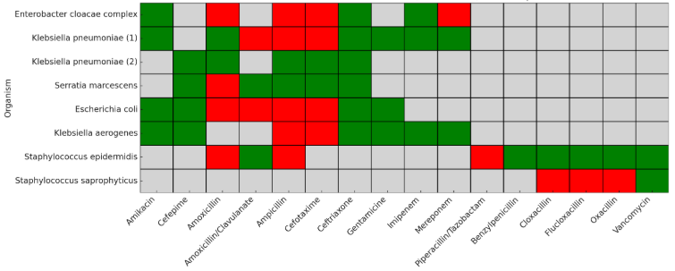
EVD Infection Antibiotic resistant Pattern

Slide 12
Results /Discussion
The study reported a 9% rate, aligning with global infection incidence ranging from 9–20% (Zhou et al,2019)
The study found that most EVD infections were linked to gram-negative bacteria, in contrast to Western studies, which report gram-positive organisms as the predominant cause of EVD infections PubMed+1
Susceptibility ranged from 25% (S. saprophyticus) to 100% (one K. pneumoniae isolate), with most Gram-negative organisms in the 60–75% range. No organism was resistant to carbapenem. This study findings is in keeping with Rojas-Lora et al(2023)and Kelemen et al(2024) findings highlighting local susceptibility profiles and emphasize on tailoring empirical therapy to local antibiograms because pathogen distribution and resistance patterns vary by unit/region.

Slide 13
Recommendations
ERI Surveillance and case reviews
Development of local antibiogram
Multimodal insertion and maintenance bundles (strict sterile insertion, dressing protocols, limit personnel in room, standardized handling and sampling policies)
Future research on risk factors for ERI

Slide 14
Conclusion
EVD infections remain a major clinical challenge in neurosurgery within resource-constrained healthcare systems.
High infection rates and poor outcomes underscore the need for urgent interventions:
  Sstandardized EVD care protocols/Bundles
  Consistent staff training
  Robust infection surveillance
  Context-specific antimicrobial stewardship initiatives.

Slide 15
References
Ramanan, M., Lipman, J., Shorr, A., & Shankar, A. (2015). A meta-analysis of ventriculostomy-associated cerebrospinal fluid infections. BMC Infectious Diseases, 15(1), 3. https://doi.org/10.1186/s12879-014-0725-0
Yu-Jie Zhou, Jing-Nan Wu, Li-Jing Chen, Hong-Yang Zhao(2019)Comparison of infection rate with tunneled vs standard external ventricular drainage: A prospective, randomized controlled trial, Clinical Neurology and Neurosurgery,Vol 184, https://www.sciencedirect.com/science/article/pii/S0303846719302124
Rojas-Lora, M., et al. (2023). External ventriculostomy-associated infection reduction after implementation of a care bundle: Microbiology and outcomes. Annals of Clinical Microbiology and Antimicrobials. BioMed Central
Kelemen, J., et al. (2024). Risk assessment and recommended approaches to optimize infection control and antibiotic stewardship to reduce external ventricular drain infection. Antibiotics (Basel). MDPI

Slide 16
References
Zhou, J., Chen, Z., Wang,Y., Li, X., & Zhang, Y. (2023). Risk factors for external ventricular drainage–related infection: A retrospective cohort study and meta-analysis. Frontiers in Neurology, 14,112345.https://doi.org/10.3389/fneur.2023.112345
Andrade, A. Y. T., Silva, G. H., & Oliveira, A. F. (2024). Risk factors for infection associated with the use of external ventricular drains: A systematic review and meta-analysis. Journal of Clinical Neuroscience, 119, 74–83. https://doi.org/10.1016/j.jocn.2024.01.012
Rojas-Lora, M., & Choo, Y. H. (2022). Bundle interventions for prevention of external ventricular drain infections: A systematic review. Neurocritical Care, 37(3), 987–996. https://doi.org/10.1007/s12028-021-01281-5
Nielsen, P. (2024). Ventriculostomy-associated infection in patients with acute brain injury: Incidence and diagnostic challenges. Acta Neurochirurgica, 166(4), 765–774. https://doi.org/10.1007/s00701-024-05981-1
Tunkel, A. R., Hasbun, R., Bhimraj, A., Byers, K., Kaplan, S. L., Scheld, W. M., van de Beek, D., & Bleck, T. P. (2017). 2017 Infectious Diseases Society of America’s clinical practice guidelines for healthcare-associated ventriculitis and meningitis. Clinical Infectious Diseases, 64(6), e34–e65. https://doi.org/10.1093/cid/ciw861

Slide 17
Acknowledgement
The Aga Khan University Hospital
The AKUH IPC team
Informaticist
IPNET

Slide 18


